Slide 1

MongoDB Databases
Chapter 1 – MongoDB Server and Tools

Slide 2
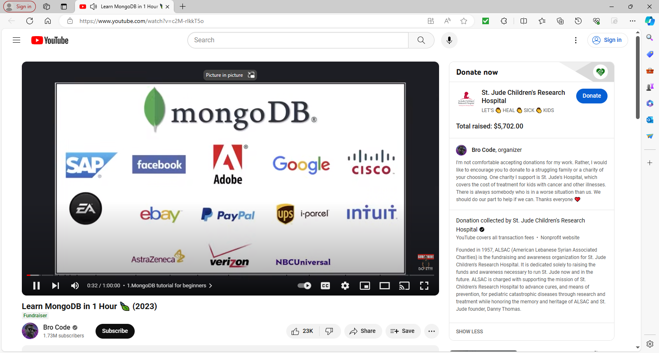
1.1. MongoDB in 1 Hour
Video Lecture
Learn MongoDB in 1 Hour 🍃 (2023) – YouTube
© 2024 Web Age Solutions All rights reserved

Slide 3
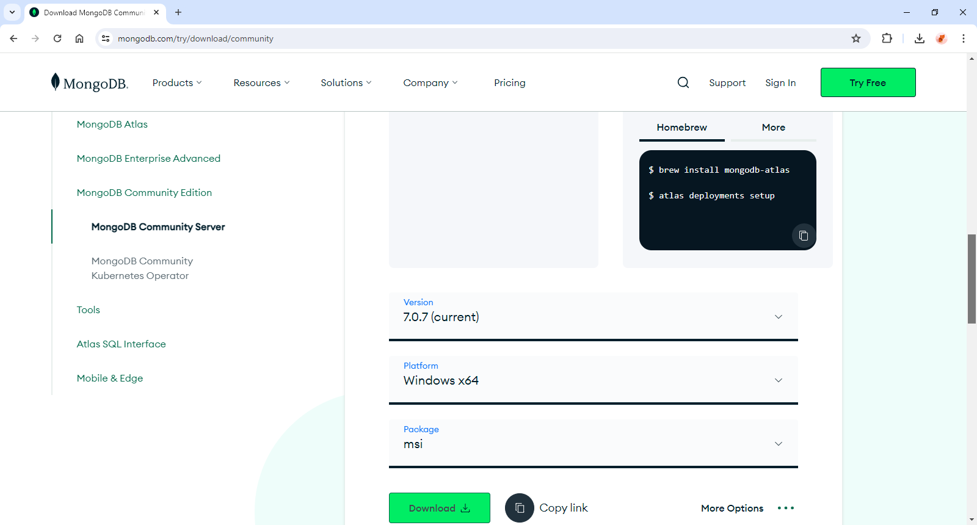
1.2 MongoDB Installation
Download and Install MongoDB 6.x
https://www.mongodb.com/try/download/community
https://www.mongodb.com/docs/v6.0/tutorial/install-mongodb-on-windows/
© 2024 Web Age Solutions All rights reserved

Slide 4
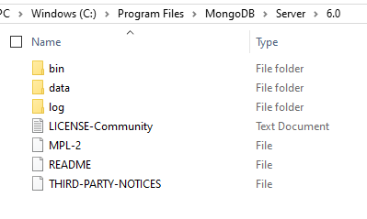
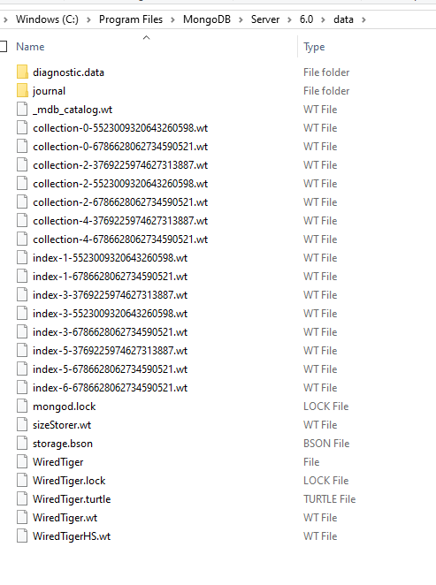
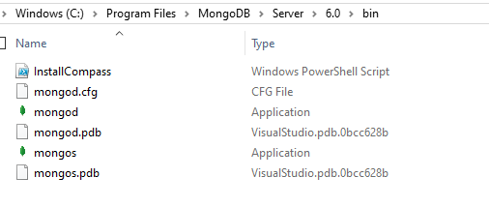
1.3 MongoDB Directory Structure

Slide 5
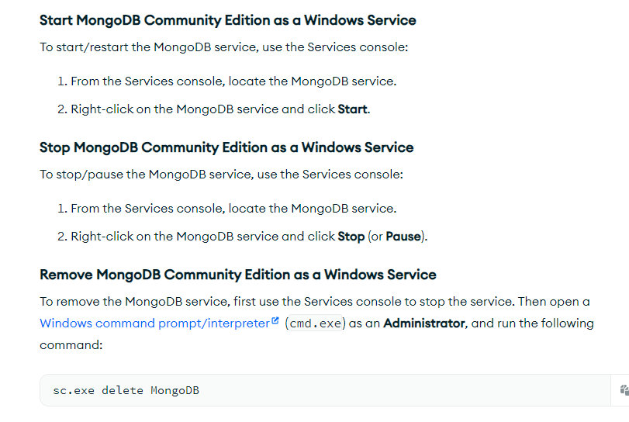
1.4 MongoDB Resources
MongoDB Configuration
C:\Program Files\MongoDB\Server\6.0\bin\mongod.cfg
How to start MongoDB server instance ?
"C:\Program Files\MongoDB\Server\6.0\bin\mongod.exe"

Slide 6
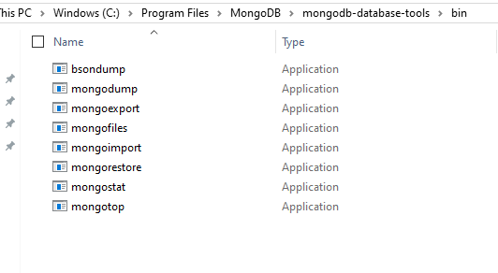
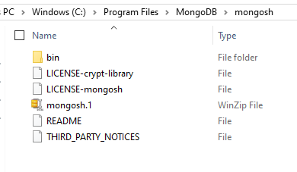
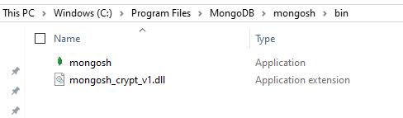
1.5 MongoDB Tools
MongoDB Tools
https://www.mongodb.com/try/download/tools
Download MongoDB Command Line Database Tools
Download MongoDB Shell and learn to use it
Download MongoDB Command Line Tools and learn to use it

Slide 7
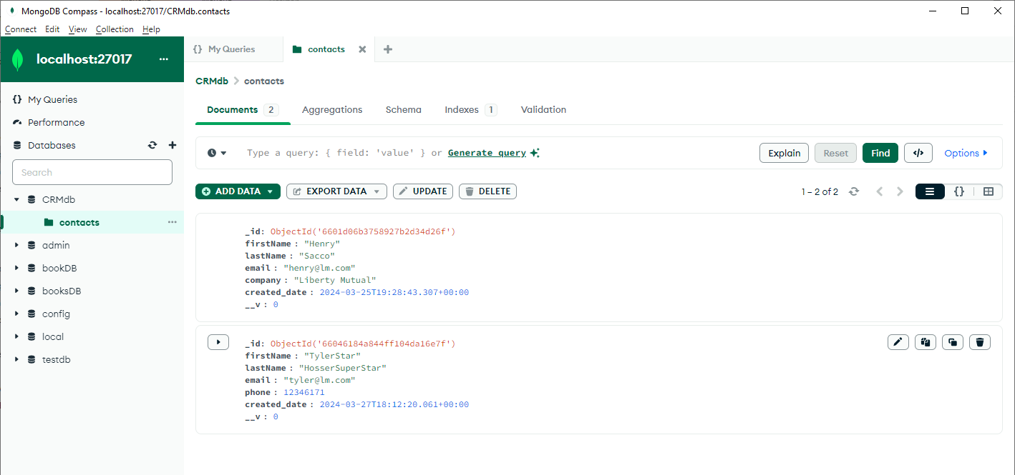
1.6 MongoDB GUI Tool
MongoDB Compass
Install it with MongoDB Server
Download and Install separately
Robo 3 T – Studio 3 T
Robo 3T is now Studio 3 T
https://robomongo.org/
Download Studio 3T and install

Slide 8
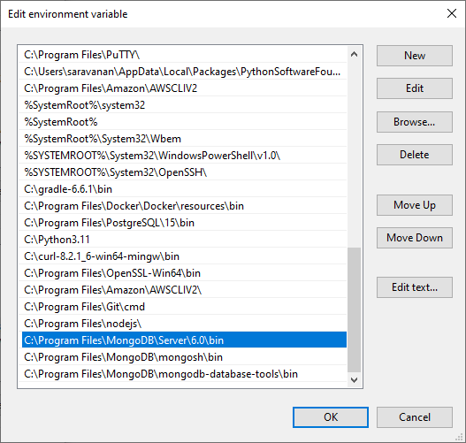
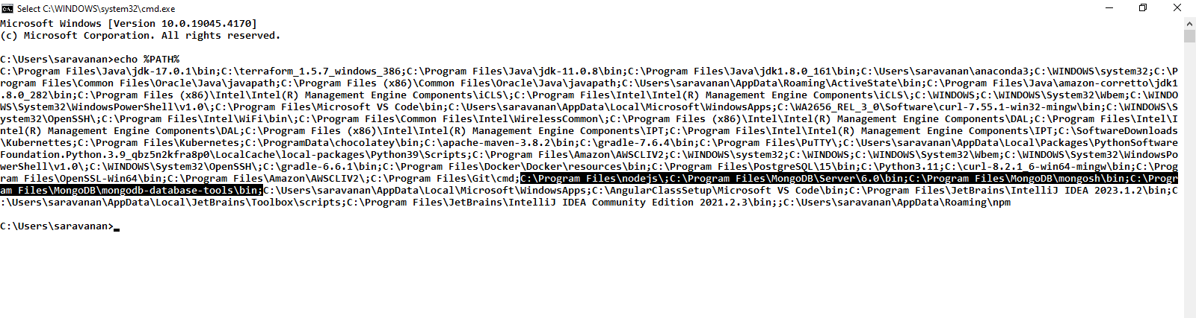
1.7 Configure System Path
Configure your system path to include MongoDB, Admin Tools bin directory in the path
C:\Program Files\MongoDB\Server\6.0\bin
C:\Program Files\MongoDB\mongosh\bin
C:\Program Files\MongoDB\mongodb-database-tools\bin
After setting path, open a cmd window and verify
mongod –help
mongosh –help
mongoimport –help
mongoexport --help

Slide 9
MongoDB Databases
Chapter 2 – Working with MongoDB

Slide 10
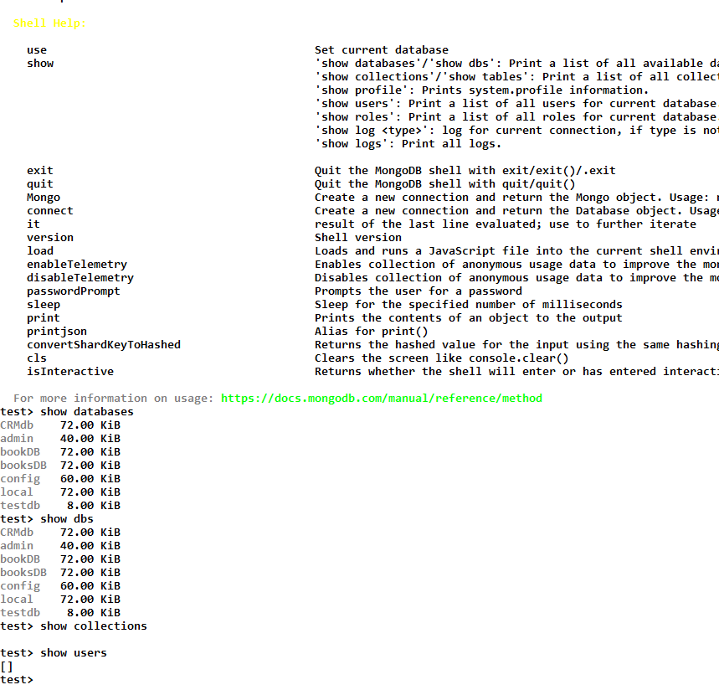
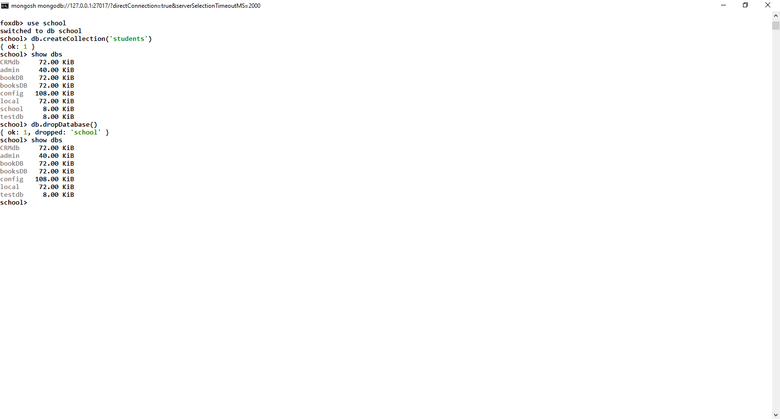
2.1. MongoDB CLI Tool
open a cmd window and type the commands
mongosh
In Admin shell, type the commands
help
show databases
show dbs
show users
show collections
sleep(10000)
show(logs)
use school
See the documentation
See the cheat sheet
© 2024 Web Age Solutions All rights reserved

Slide 11
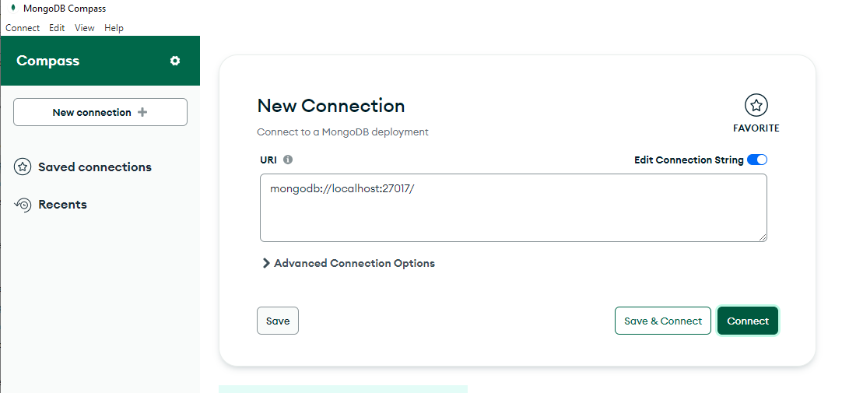

2.2. MongoDB Compass
© 2024 Web Age Solutions All rights reserved

Slide 12
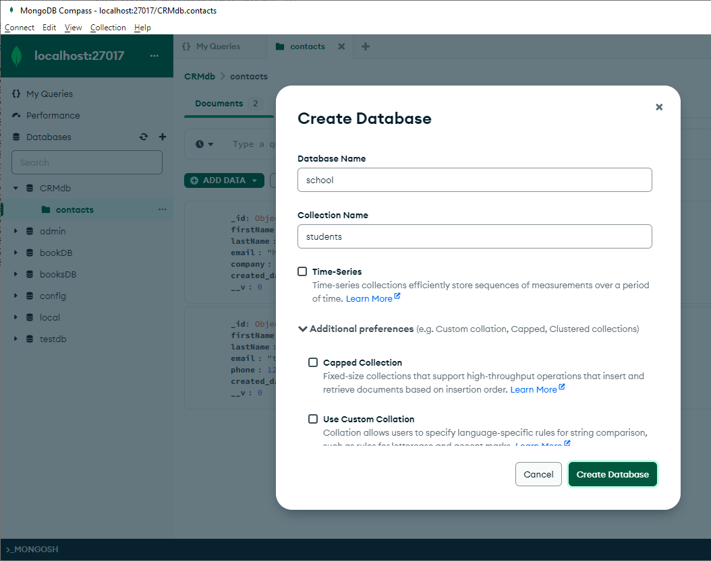
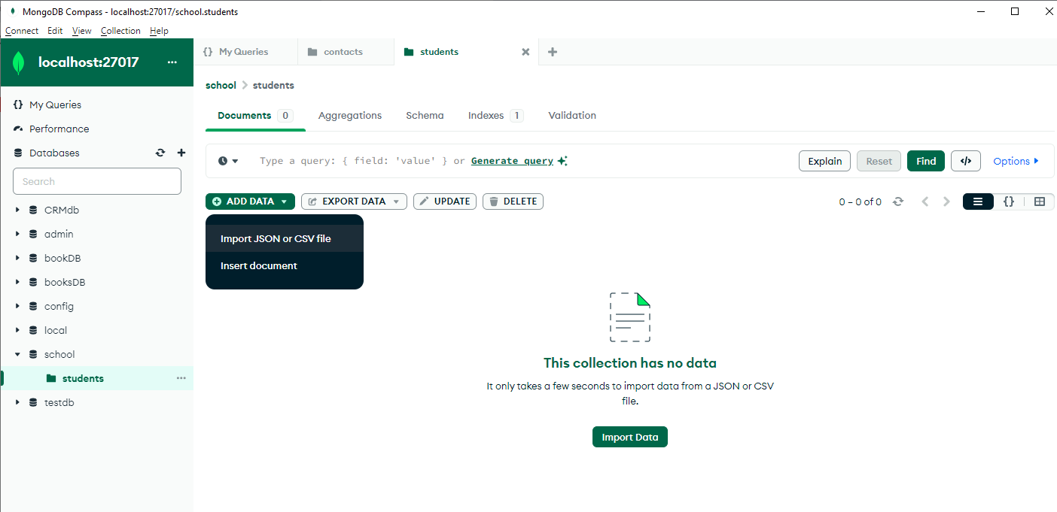
2.3. MongoDB Compass – what can you do?
© 2024 Web Age Solutions All rights reserved

Slide 13
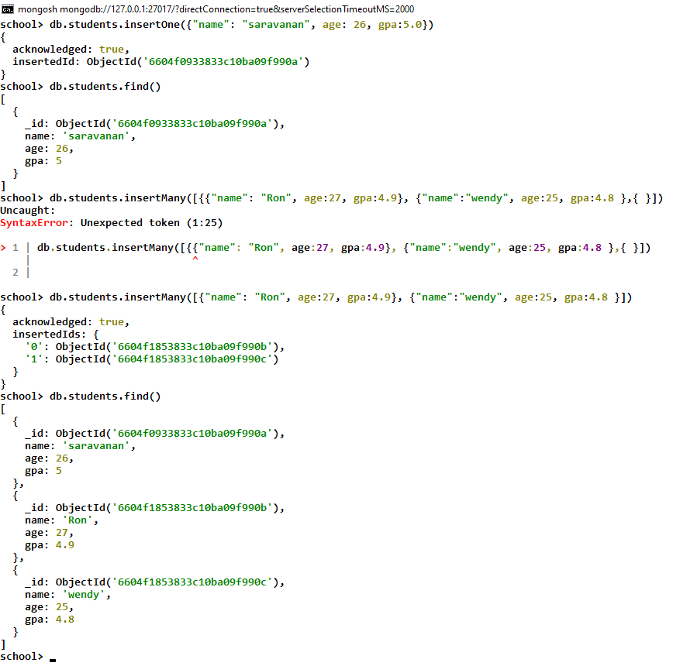
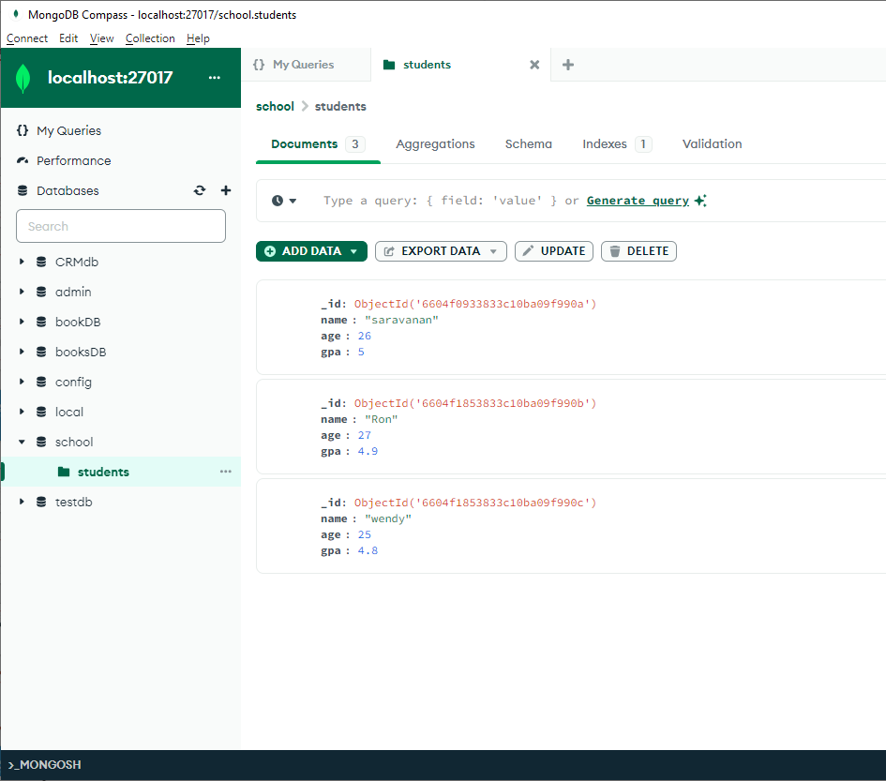
2.4. MongoDB commands examples
© 2024 Web Age Solutions All rights reserved

Slide 14
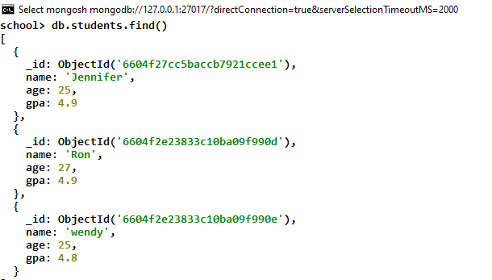
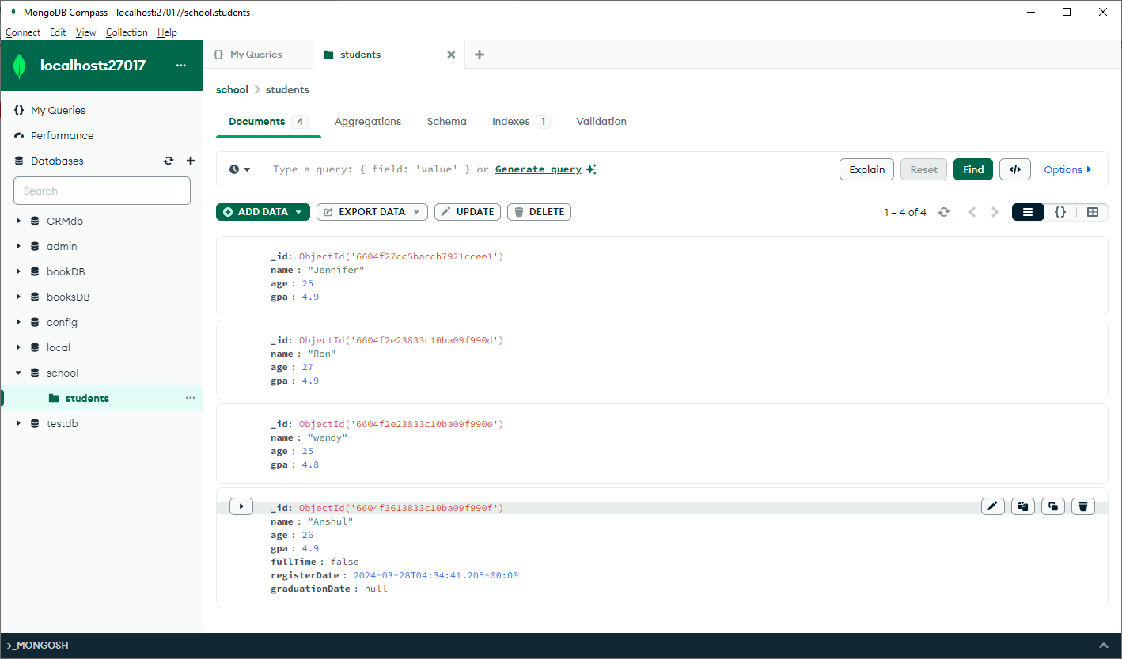
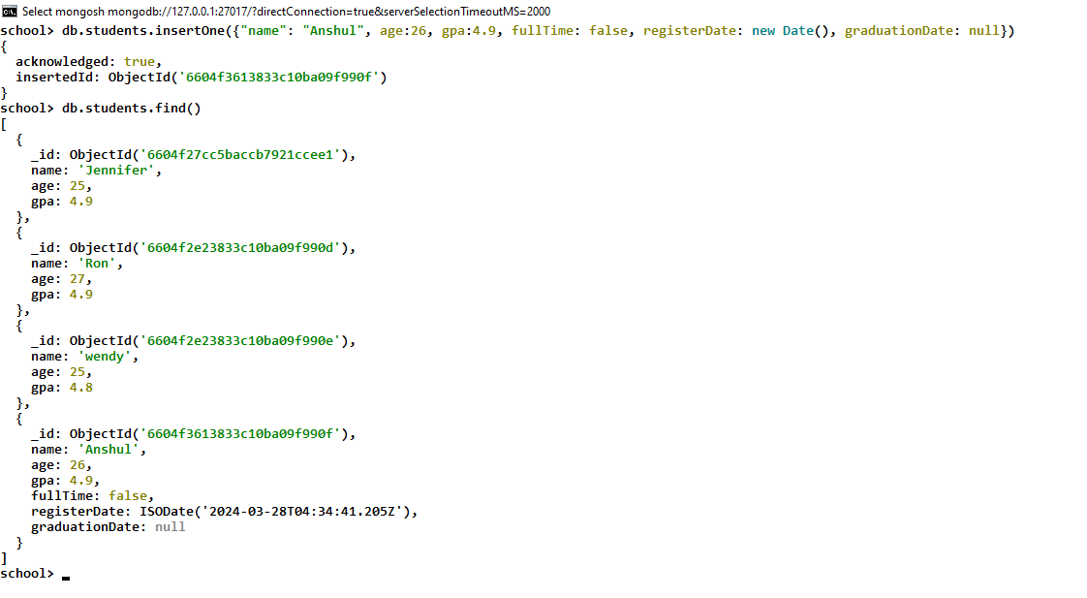
2.5. MongoDB commands examples
© 2024 Web Age Solutions All rights reserved

Slide 15
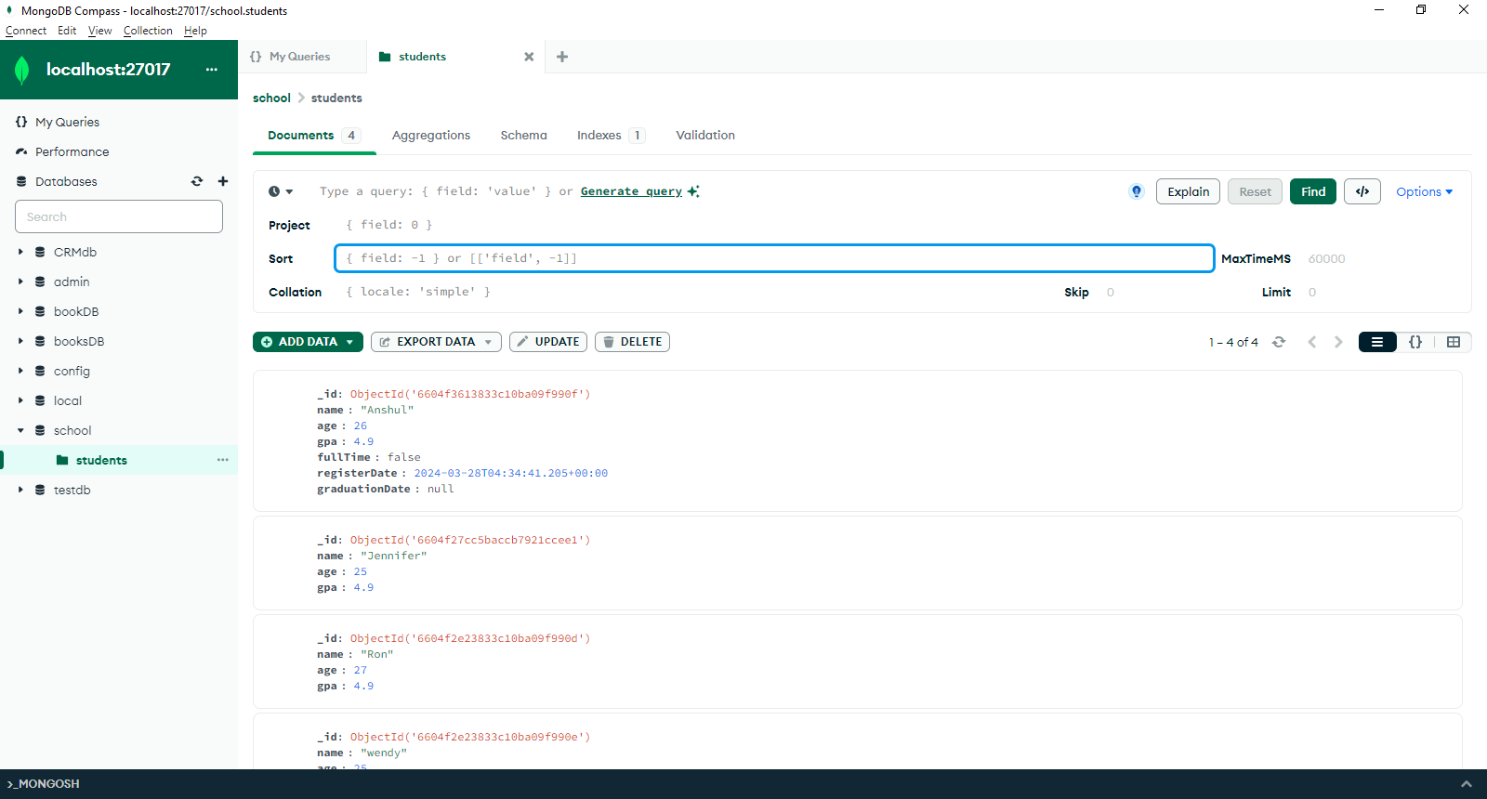
2.6. MongoDB commands examples
db.students.find().sort({name: 1})
db.students.find().sort({name: -1})
db.students.find().sort({gpa: -1})
db.students.find().sort({gpa: 1})
db.students.find().limit(1)
db.students.find().limit(2)
db.students.find().limit(3)
db.students.find().sort({gpa: 1}).limit(1)
db.students.find().sort({gpa: -1}).limit(1)
© 2024 Web Age Solutions All rights reserved

Slide 16
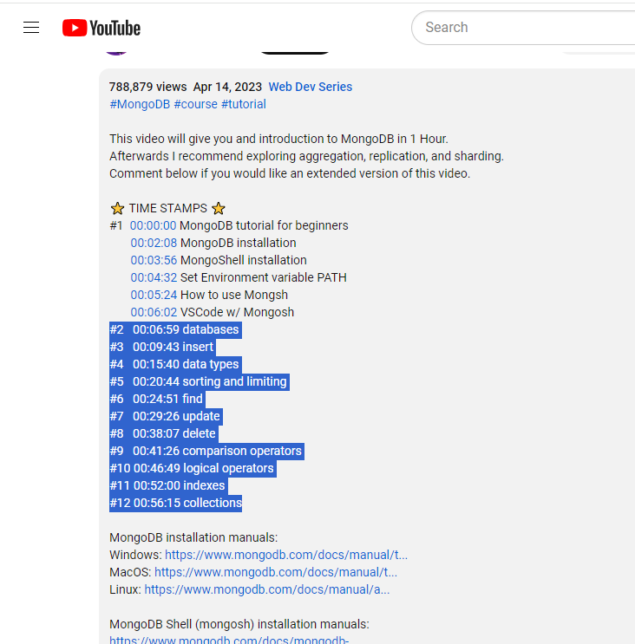
2.7. Working with MongoDB Exercises
© 2024 Web Age Solutions All rights reserved

Slide 17
MongoDB Databases
WebAge Course Materials

Slide 18
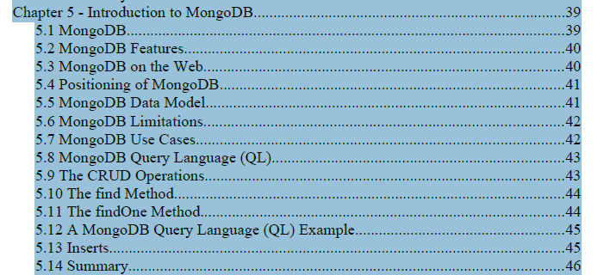
WA3476 Chapter 5 Introduction to MongoDB
© 2024 Web Age Solutions All rights reserved

Slide 19
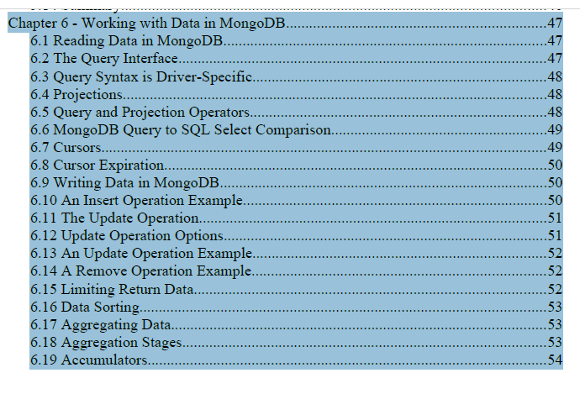
WA3476 Chapter 6 Working with Data in MongoDB
© 2024 Web Age Solutions All rights reserved

Slide 20
MongoDB Additional Resources and References
https://www.w3schools.com/mongodb/index.php
https://www.mongodb.com/docs/manual/tutorial/query-documents/
https://www.mongodb.com/docs/manual/crud/
https://www.mongodb.com/basics/examples
https://www.geeksforgeeks.org/mongodb-crud-operations
https://github.com/mattdavis0351/mongodb-labs/tree/master/exercises
https://github.com/DanteDeRuwe/mongodb-exercises
© 2024 Web Age Solutions All rights reserved

